Slide 1

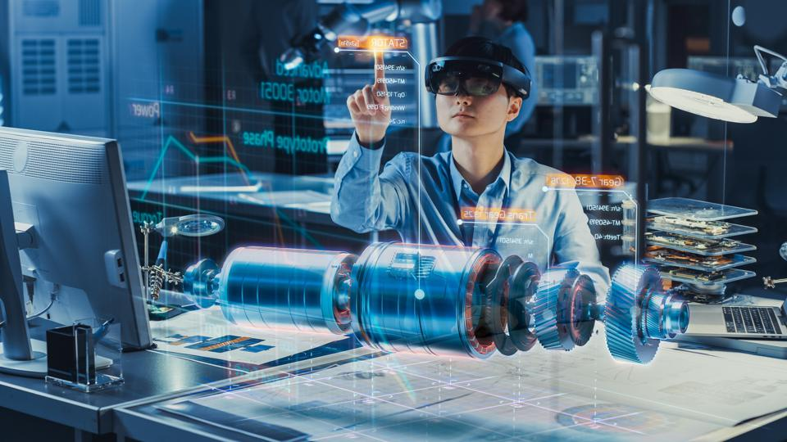
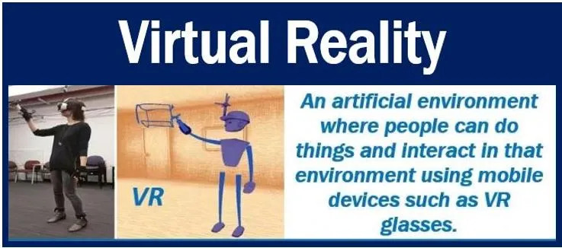
Introduction to Virtual Reality

Slide 2
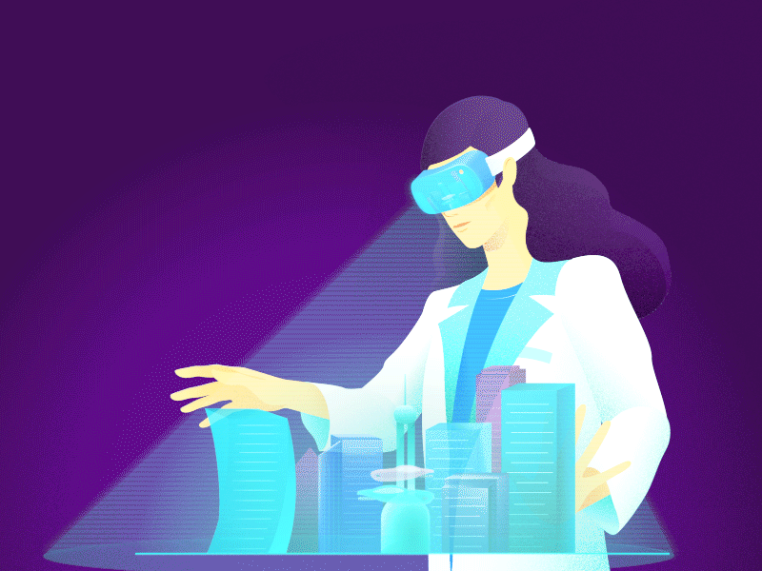
Introduction
Virtual Reality (VR) is a computer-generated environment with scenes and objects that appear to be real, making the user feel they are immersed in their surroundings. This environment is perceived through a device known as a Virtual Reality headset or helmet.
VR allows us to immerse ourselves in videogames as if we were one of the characters, learn how to perform heart surgery or improve the quality of sports training to maximise performance.

Slide 3
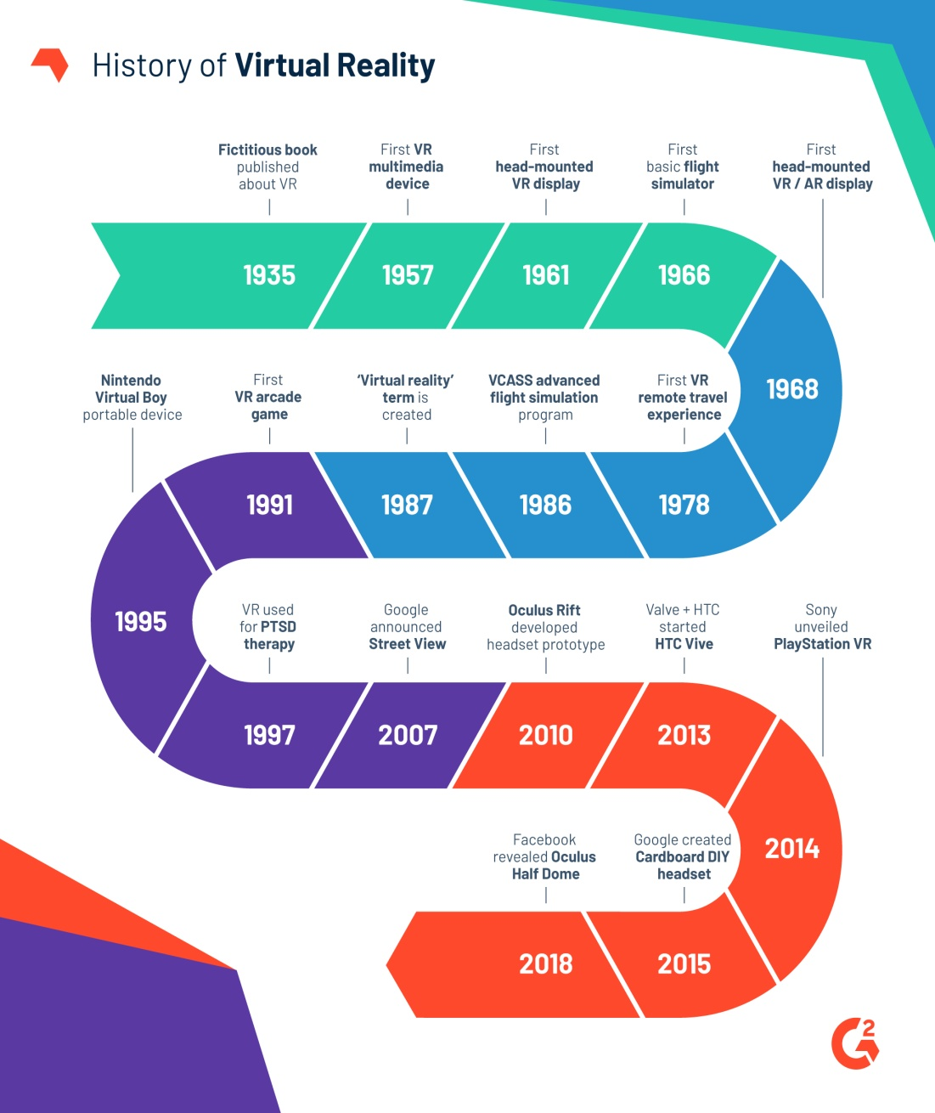
Timeline of VR
Today’s virtual reality technologies build upon ideas that date back to the 1800s, almost to the very beginning of practical photography. In 1838, the first stereoscope was invented, using twin mirrors to project a single image.
That eventually developed into the View-Master, patented in 1939 and still produced today.
The use of the term “virtual reality,” however, was first used in the mid-1980s when Jaron Lanier, founder of VPL Research, began to develop the gear, including goggles and gloves, needed to experience what he called “virtual reality.”

Slide 4
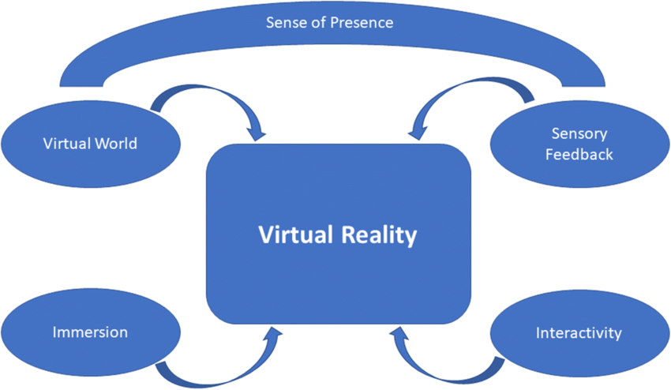
Key Elements of VR
In book, Understanding Virtual Reality, Interface, Application, and Design, William R. Sherman, and Alan B. Craig, define 4 key elements of virtual reality experience:

Slide 5
Key Elements of VR
Virtual world:
Imaginary space that independently exist from the real world. The medium used to create this space is of course a simulation made of visual elements rendered with computer graphics. Relations and interactions between these elements are defined by rules set by the creator.
Immersion
The users are placed in a virtual space, cut from the real world on a sensory level. VR headsets allow this by occupying their whole field of vision, while headphones achieve the same results with sounds, thus fully immersing the users in another world.

Slide 6
Key Elements of VR
Sensory feedback
Vr headsets track the position of the users within a given space so that the computer renders the changes of positions. Users moving their heads or bodies will be given the illusion that they are moving in the virtual world. The input here is as close to reality as possible, to move around users don’t press a button, they actually move around.
Interactivity
To feel real, a simulated environment should include virtual elements we can interact with: picking up an item, swinging a sword to kill a goblin, breaking a mug, pushing the ignition button of plane in a flight simulator, etc.

Slide 7
Types of VR
Let’s take a look at different types of virtual reality and how they engage users in their specific ways.
1- Non-immersive Virtual Reality.
2-Fully Immersive Virtual Reality.
3- Semi-Immersive Virtual Reality.
4- Augmented Reality.
5- Collaborative VR.

Slide 8
Non-immersive Virtual Reality
Non-immersive virtual reality is a type of virtual reality in which you interact with a virtual environment usually through a computer where you can control some characters or activities within the experience, but the virtual environment is not directly interacting with you.
A good example of non-immersive virtual reality would be a computer game like Dota 2. You can control aspects of your character and they will have an effect on the virtual environment of the game. Technically you are interacting with a virtual environment but not directly. Your character in the game does that.

Slide 9
Fully Immersive Virtual Reality
Fully immersive virtual reality is the opposite of non-immersive virtual reality. It ensures a realistic virtual experience. It would feel as if you are physically present in the virtual world and the events occurring there are happening to you.
Special equipment like VR glasses, gloves, body detectors equipped with sense detectors is required to provide a realistic virtual experience. The data from these sensors is used by the computer and the virtual world responds to that in real-time to provide users with a realistic virtual experience.
An example of this would be a Virtual Gaming Zone, where using special gear you and other players can interact with the virtual environment, all at the same time, and play with or against each other.

Slide 10
Semi-Immersive Virtual Reality
A semi-immersive virtual reality is something in between non-immersive and fully immersive virtual reality. Using a computer screen or VR glasses, you can move around in a virtual environment but other than your visual experience you will have no physical sensations to enhance the experience.
A virtual tour can be a good example of semi-immersive virtual technology. It can be device-based or web-based. Many businesses are opting for this technology as participants can roam around the place without having to be there physically.

Slide 11
Augmented Reality
Augmented Reality is a type of virtual reality that lets the user see the real world usually through a phone screen and make virtual changes to it on the screen. A good example that will help you better understand augmented reality is the mobile game application Pokémon Go.
You can turn on your phone’s camera and point it to a place where you suspect Pokémon will be. Your phone screen would then display the Pokémon on your screen, as though it’s in the photo’s frame. They only appear in the environment of your screen and there’s no physical addition to the area being filmed.

Slide 12
Collaborative VR
This a type of virtual reality where users from different locations can come together in a virtual environment in the form of 3D projected characters. A virtual environment of a mobile game like Player Unknowns Battlegrounds (PUBG), where virtual 3D characters of different players come together and they all interact with each other’s virtual personas in that environment, is a good example of Collaborative VR.

Slide 13
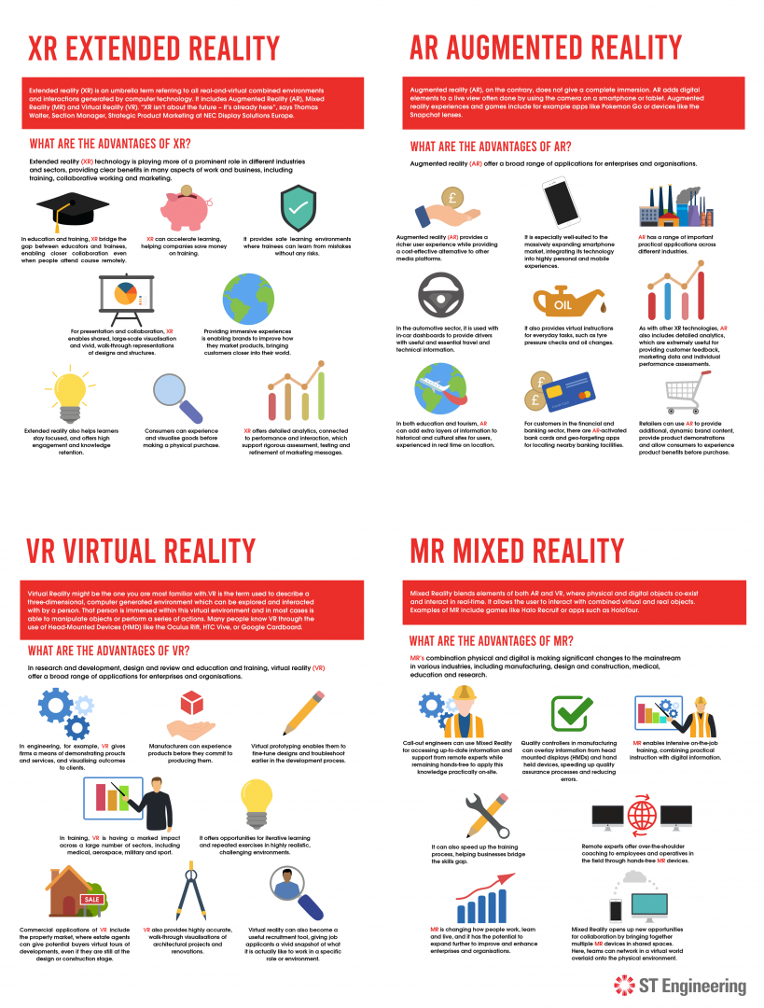
Applications of VR

Slide 14
Applications of VR

Slide 15
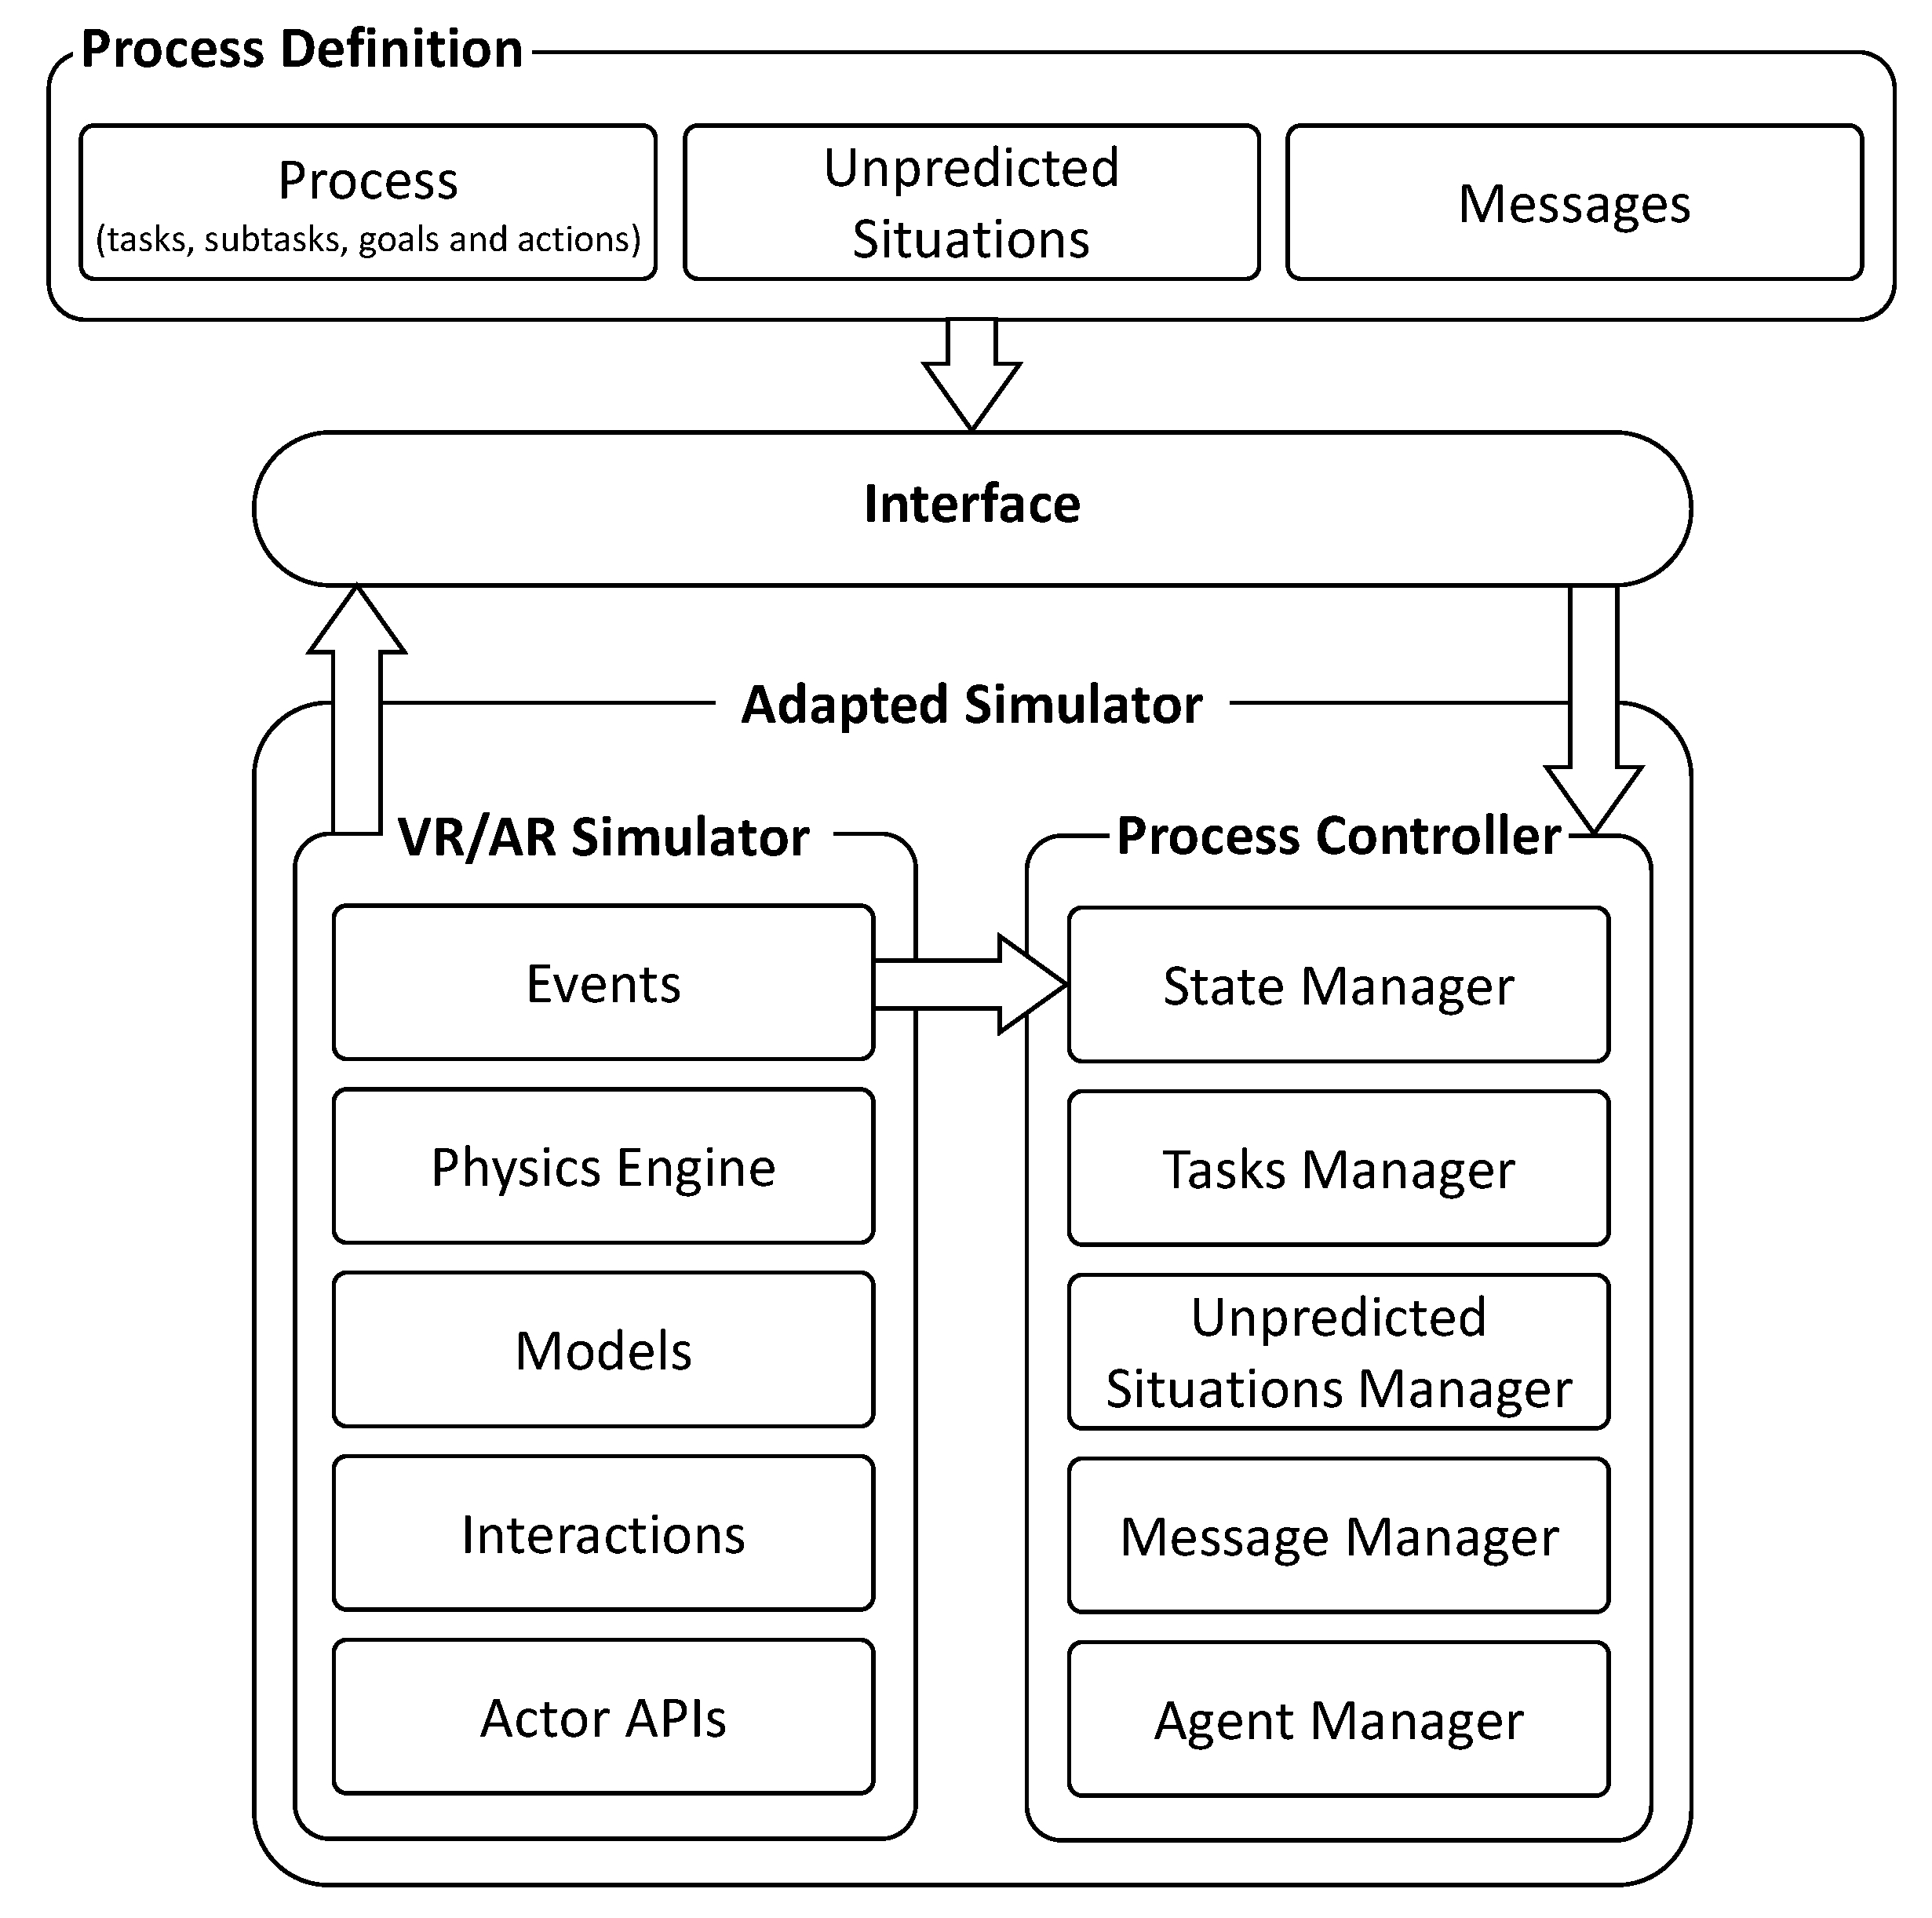
Process flow of VR Development

Slide 16
What is VRML?
VRML stands for Virtual Reality Modelling Language and is pronounced ‘vermil’.
It is a standard for delivering 3D rendering on the net, just like HTML is a standard for web pages.
VRML is a subset of the Open Inventor standard developed by SGI for their graphics workstation.

Slide 17
The ‘World’ representation
VRML includes many of the things that go into making a world. It has a way of describing geometry which creates objects and spaces in which you can move around, as well as light, texture and sound which can be approached and viewed from whatever angle.
It is from this ‘worldly’ imitation that VRML files get their name. The files are called ‘worlds’ and have ‘.wrl’ extension.

Slide 18
VRML 1.0
This is the first generation of VRML.
It describes the foundations of a world including geometry, lighting, color, texture and linking.
VRML 1.0 is designed to meet the following requirements:
Platform independence
Extensibility
Ability to work well over low-bandwidth connections
No support for interactive behaviors

Slide 19
VRML 2.0
This is the current generation of VRML.
It has a richer level for interactivity and includes support for animation, spatial sound and scripting in addition to features that are already supported in VRML 1.0.
VRML Architecture Board made it official in March 1996

Slide 20
VRML97
VRML 97 is the ISO standard for VRML
It is developed based on VRML 2.0

Slide 21
Features in VRML97
More realism in static worlds
Sound objects with controllable attenuation
An efficient system to describe irregular ground terrains
Extrusion objects for advanced but compact modelling
A more powerful background coloring and panorama system
A fog system allowing underwater and cloudy environments to be represented
The ability to use MPEG video as a texture map

Slide 22
Features in VRML97
Interaction from sensors:
Collision detection gives the user a sense of substance as they move in the world
Touch sensors allow reactions to a users deliberate actions
Proximity sensors allow reactions to a user’s not so deliberate actions
Visibility sensors allow conservation of resources

Slide 23
Features in VRML97
Motion, behaviors and beyond:
Interpolators provide engines to implement animation of any sort.
Scripting in JavaScript or Java allows everything from simple logic devices to fully blown analytical engines providing a wealth of complexity.
Prototypes extend the existing variety of object types with efficient reuse and simple scene graph structure.
A navigation information object provides the browser software with details of the speed and nature of the users movements in the world.

Slide 24
Writing VRML descriptions
VRML code is simply a text file, case sensitive
Header:
#VRML V2.0 utf8
Comments indicated by ‘#’ sign
Terminology:
Nodes: a world is made up of nodes which are types of objects
Fields: describe properties of a node

Slide 25
Example
#VRML V2.0 utf8
WorldInfo {
title "Example 1"
}
DEF FBOX Shape {
appearance Appearance {
material Material {
diffuseColor 0 0.5 0
}
}
geometry Box {
}
}
Node
Field
(uses default values)

Slide 26
Transformations and Matrices
Transformations are functions
Matrices are functions representations
Matrices represent linear transformation
{2x2 Matrices} ⇔ {2D Linear Transformation}

Slide 27
Transformations (1/3)
What are they?
changing something to something else via rules
mathematics: mapping between values in a range set and domain set (function/relation)
geometric: translate, rotate, scale, shear,…
Why are they important to graphics?
moving objects on screen / in space
mapping from model space to screen space
specifying parent/child relationships
…

Slide 28
Transformation (2/3)
Translation
Moving an object
Scale
Changing the size of an object
t_{y}
t_{x}
x_{new} = x_{old} + t_{x}; y_{new} = y_{old} + t_{y}
h_{new}
h_{old}
w_{old}
w_{new}
s_{x}=w_{new}/w_{old} s_{y}=h_{new}/h_{old}
x_{new} = s_{x}x_{old} y_{new} = s_{y}y_{old}

Slide 29
Transformation (3/3)
To rotate a line or polygon, we must rotate each of its vertices
Shear
(x,y)
Original Data y Shear x Shear

Slide 30
What is a 2D Linear Transform?
Example

Slide 31
Example
Scale in x by 2

Slide 32
Transformations: Translation (1/2)
A translation is a straight line movement of an object from one position to another.
A point (x,y) is transformed to the point (x’,y’) by adding the translation distances T_{x} and T_{y}:
x’ = x + T_{x}
y’ = y + T_{y}

Slide 33
Transformations: Translation(2/2)
moving a point by a given t_{x} and t_{y} amount
e.g. point P is translated to point P’
moving a line by a given t_{x} and t_{y} amount
translate each of the 2 endpoints

Slide 34
Transformations: Rotation (1/4)
Objects rotated according to angle of rotation theta (θ)
Suppose a point P(x,y) is transformed to the point P'(x',y') by an anti-clockwise rotation about the origin by an angle of θ degrees, then:
Given x = r cos φ , y = r sin φ
x’ = x cos θ – y sin θ
y’ = y sin θ + y cos θ

Slide 35
Transformations: Rotation (2/4)
Rotation P by θ anticlockwise relative to origin (0,0)

Slide 36
Transformations: Rotation (3/4)
Rotation about an arbitary pivot point (x_{R},y_{R})
Step 1: translation of the object by (-x_{R},-y_{R})
x₁ = x - x_{R}
y₁ = y - y_{R}
Step 2: rotation about the origin
x₂ = x₁ cos(θ) - y₁sin (θ)
y₂ = y₁cos(θ) - x₁sin (θ)
Step 3: translation of the rotated object by (xR,yR)
x’ = x_{r} + x₂
y’ = y_{r} + y₂

Slide 37
Transformations: Rotation (4/4)
object can be rotated around an arbitrary point (x_{r},y_{r}) known as rotation or pivot point by:
x' = x_{r} + (x - x_{r}) cos(θ) - (y - y_{r}) sin (θ)
y' = y_{r} + (x - x_{r}) sin (θ)+(y - y_{r}) cos(θ)

Slide 38
Transformations: Scaling (1/5)
Scaling changes the size of an object
Achieved by applying scaling factors s_{x} and s_{y}
Scaling factors are applied to the X and Y co-ordinates of points defining an object’s

Slide 39
Transformations: Scaling (2/5)
uniform scaling is produced when s_{x} and s_{y} have same value i.e. s_{x} = s_{y}
non-uniform scaling is produced when s_{x} and s_{x} are not equal - e.g. an ellipse from a circle.
i.e. s_{x} ≠ s_{y}
x₂ = s_{x}x₁ y₂ = s_{y}y₁

Slide 40
Transformations: Scaling (3/5)
Simple scaling - relative to (0,0)
General form:
Ex: s_{x} = 2 and s_{y}=1

Slide 41
Transformations: Scaling (4/5)
If the point (x_{f},y_{f}) is to be the fixed point, the transformation is: x' = x_{f} + (x - x_{f}) S_{x} y' = y_{f} + (y - y_{f}) S_{y} This can be rearranged to give: x' = x S_{x} + (1 - S_{x}) x_{f} y' = y S_{y} + (1 - S_{y}) y_{f} which is a combination of a scaling about the origin and a translation.

Slide 42
Transformations: Scaling (5/5)

Slide 43
Transformation as Matrices
Scale:
x’ = s_{x}x
y’ = s_{y}y
Rotation:
x’ = xcosθ - ysin θ
y’ = xsin θ + ycos θ
Translation:
x’ = x + t_{x}
y’ = y + t_{y}

Slide 44
Transformations: Shear (1/2)
Shear in x:

Slide 45
Transformations: Shear (2/2)
Shear in y:

Slide 46
Shear in x then in y

Slide 47
Shear in y then in x

Slide 48
Homogeneous coordinate
As translations do not have a 2 x 2 matrix representation, we introduce homogeneous coordinates to allow a 3 x 3 matrix representation.
The Homogeneous coordinate corresponding to the point (x,y) is the triple (x_{h}, y_{h}, w) where: x_{h} = wx y_{h} = wy For the two dimensional transformations we can set w = 1.

Slide 49
Matrix representation

Slide 50
Basic Transformation (1/3)
Translation

Slide 51
Basic Transformation (2/3)
Rotation

Slide 52
Basic Transformation (3/3)
Scaling

Slide 53
Composite Transformation
Suppose we wished to perform multiple transformations on a point:

Slide 54
Example of Composite Transformation(1/3)
A scaling transformation at an arbitrary angle is a combination of two rotations and a scaling: R(-t) S(S_{x},S_{y}) R(t)
A rotation about an arbitrary point (x_{f},y_{f}) by and angle t anti-clockwise has matrix: T(-x_{f},-y_{f}) R(t) T(x_{f},y_{f})

Slide 55
Example of Composite Transformation(2/3)
Reflection about the y-axis Reflection about the x-axis

Slide 56
Example of Composite Transformation(3/3)
Reflection about the origin Reflection about the line y=x

Slide 57
3D Transformation
Y
Y
Z
X
X
Z

Slide 58
Basic 3D Transformations
Translation
Scale
Rotation
Shear
As in 2D, we use homogeneous coordinates (x,y,z,w), so that transformations may be composited together via matrix multiplication.

Slide 59
3D Translation and Scaling
TP = (x + t_{x}, y + t_{y}, z + t_{z})
SP = (s_{x}x, s_{y}y, s_{z}z)

Slide 60
3D Rotation (1/4)
Positive Rotations are defined as follows:
Axis of rotation is Direction of positive rotation is
x y to z
y z to x
z x to y

Slide 61
3D Rotation (2/4)
Rotation about x-axis R_{x}(ß)P

Slide 62
3D Rotation (3/4)
Rotation about y-axis R_{y}(ß)P

Slide 63
3D Rotation (4/4)
Rotation about z-axis R_{z}(ß)P

Slide 64
3D Shear
xy Shear: SH_{xy}P

Slide 65
Rotation About An Arbitary Axis (1/3)
P₂
Translate one end of the axis to the origin
Rotate about the y-axis and angle β
Rotate about the x-axis through an angle μ
Z
U
P₁
u₃
c
Y
a
ß
u₂
b
u₁
X

Slide 66
Rotation About An Arbitary Axis (2/3)
P₂
Z
Z
U
U
Z
P₁
u₃
c
c
a
u₃
Y
a
a
Y
ß
µ
u₂
ß
Y
u₂
b
u₂
b
u₁
u₁
X
X
X
4. When U is aligned with the z-axis, apply the original rotation, R, about the z-axis.
5. Apply the inverses of the transformations in reverse order.

Slide 67
Rotation About An Arbitary Axis (3/3)
T⁻¹ R_{y}(ß) R_{x}(-µ) R R_{x}(µ) R_{y}(-ß) T P

Slide 68
Shapes
Box
geometry Box {size 5.5 3.75 1.0}
Cylinder
geometry Cylinder {radius 0.5 height 10 top FALSE}
Cone
geometry Cone {bottomRadius 5 height 10 side TRUE bottom FALSE}
Sphere
geometry Sphere { radius 10,000,000}
Text & FontStyle

Slide 69
Materials
Material Node properties:
diffuseColor: The normal color of the object
specularColor: The color of highlights on shiny objects
emissiveColor: The object 'glows' with a light of it's own of this color. It doesn't cast light on any other objects though
ambientIntensity: The amount of ambient light that the object reflects
shininess: How reflective the object is
transparency: How transparent the object is. Note, some browsers will not support partly-transparent objects.

Slide 70
Transformations
Distances measured in meters (convention)
Angles measured in radians
Transformation types:
Translation, Rotation, and Scaling
Applied in following order (use nesting for custom)
Scale, then Rotate, the Translate
Example:
Transform {
translation 1 1 1
rotation 0 1 0 0.78
scale 2 1 2
children [
USE FBOX
]

Slide 71
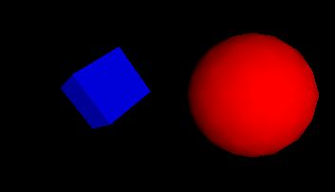
Example 1
#VRML V2.0 utf8
Transform {
children [
NavigationInfo { headlight FALSE } # We'll add our own light
DirectionalLight { # First child
direction 0 0 -1 # Light illuminating the scene
}
Transform { # Second child - a red sphere
translation 3 0 1
children [
Shape {
geometry Sphere { radius 2.3 }
appearance Appearance {
material Material { diffuseColor 1 0 0 } # Red
}
}
]
}
( … )

Slide 72
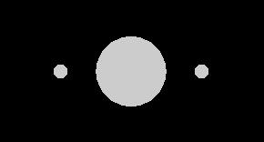
Example 2
#VRML V2.0 utf8
Transform {
children [
DEF Joe Shape { geometry Sphere {} }
Transform {
translation 2 0 0
children DEF Joe Shape { geometry Sphere { radius .2 } }
}
Transform {
translation -2 0 0
children USE Joe
}
]
}

Slide 73
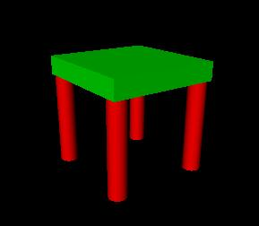
Example 3
#VRML V2.0 utf8
PROTO TwoColorTable [ field SFColor legColor .8 .4 .7
field SFColor topColor .6 .6 .1 ]
{
Transform {
children [
Transform { # table top
translation 0 0.6 0
children
Shape {
appearance Appearance {
material Material { diffuseColor IS topColor }
}
geometry Box { size 1.2 0.2 1.2 }
}
}
Transform { # first table leg
translation -.5 0 -.5
children
DEF Leg Shape {
appearance Appearance {
material Material { diffuseColor IS legColor }
}
geometry Cylinder { height 1 radius .1 }
}
}
Transform { # another table leg
translation .5 0 -.5
children USE Leg
}
Transform { # another table leg
translation -.5 0 .5
children USE Leg
}
Transform { # another table leg
translation .5 0 .5
children USE Leg
}
] # End of root Transform's children
} # End of root Transform
} # End of prototype
# The prototype is now defined. Although it contains a
# number of nodes, only the legColor and topColor fields
# are public. Instead of using the default legColor and
# topColor, this instance of the table has red legs and
# a green top:
TwoColorTable {
legColor 1 0 0 topColor 0 1 0
}
NavigationInfo { type "EXAMINE" } # Use the Examine viewer

Slide 74
Additional Examples
Interpolation
Interaction
Tour
Distance Sensor
Graphics (1)
Graphics (2)
Graphics (3)
https://cs.lmu.edu/~ray/notes/vrmlexamples/

